Slide 1



Java MVC Frameworks
Filters and User Authentication
SoftUni Team
Technical Trainers
Software University
http://softuni.bg
Notes:
© Software University Foundation – http://softuni.org
This work is licensed under the Creative Commons Attribution-NonCommercial-ShareAlike license.
<number>

Slide 2
Table of Contents
Filters
Interceptors
Use cases
User Authentication
What’s Spring Security?
Cross-Site Request Forgery
Setting up Spring Security
<number>
Notes:
© Software University Foundation – http://softuni.org
This work is licensed under the Creative Commons Attribution-NonCommercial-ShareAlike license.
<number>

Slide 3
Have a Question?
sli.do #java-web
<number>

Slide 4

Filters

Slide 5
Filters
A filter is an object used to intercept the HTTP requests and responses of your application
We can perform two operations at two instances:
Before sending the request to the controller
Before sending a response to the client

Slide 6
Filter Example(1)
GreetingFilter.java
@Component
public class GreetingFilter implements Filter {
@Override
public void doFilter(ServletRequest servletRequest, ServletResponse servletResponse, FilterChain filterChain) throws IOException, ServletException {
HttpServletRequest request = (HttpServletRequest) servletRequest;
HttpServletResponse response = (HttpServletResponse) servletResponse;
request.getSession().setAttribute("name", "Pesho");
filterChain.doFilter(request, response);
}
}
<number>

Slide 7
Filter Example(2)
HomeController.java
@Controller
public class HomeController {
@GetMapping("/")
public ModelAndView index(ModelAndView modelAndView, HttpSession session) {
modelAndView.setViewName("index");
modelAndView.addObject("name", session.getAttribute("name"));
return modelAndView;
}
}
<number>

Slide 8
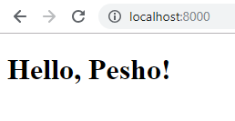
Filter Example(3)
index.html
<!DOCTYPE html>
<html lang="en" xmlns="http://www.w3.org/1999/xhtml" xmlns:th="http://www.thymeleaf.org">
<head>
<meta charset="UTF-8">
<title>Filter Demo</title>
</head>
<body>
<h1 th:text="'Hello, ' + ${name} + '!'"></h1>
</body>
</html>
<number>

Slide 9

Spring Security
<number>

Slide 10


Spring Security
Framework that focuses on providing both authentication and authorization
Authentication
Authorization
<number>

Slide 11



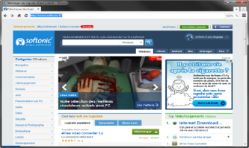



Spring Security Mechanism
Authentication Manager
Access Decision Manager
Intercept
Request
Intercept
Request
Secured Resources
Web Client
GET username password
Valid Credentials
Valid Authorization
Validate
username password
Validate Roles
Database
<number>

Slide 12
Spring Security Maven
pom.xml
<dependency>
<groupId>org.springframework.boot</groupId>
<artifactId>spring-boot-starter-security</artifactId>
</dependency>
<number>

Slide 13
Spring Security Configuration (2)
Overriding configure() method.
SecurityConfiguration.java
@Override
protected void configure(HttpSecurity http) throws Exception {
http
.authorizeRequests()
.antMatchers("/", "/register").permitAll()
.anyRequest().authenticated()
}
Authorize Requests
Permit Routes
Require Authentication
<number>

Slide 14
Registration - User
Implementing the UserDetails interface.
User.java
@Entity
public class User implements UserDetails {
private String username;
private String password;
private boolean isAccountNonExpired;
private boolean isAccountNonLocked;
private boolean isCredentialsNonExpired;
private boolean isEnabled; private Set<Role> authorities;
}
<number>

Slide 15

Registration - Roles
Implementing the GrantedAuthority interface.
Role.java
public class Role implements GrantedAuthority {
private String authority;
}
Role Interface
<number>

Slide 16
Spring Security Configuration (1)
Extending the WebSecurityConfigurerAdapter class.
SecurityConfiguration.java
@Configuration
@EnableWebSecurity
public class SecurityConfiguration extends WebSecurityConfigurerAdapter {
//Configuration goes here
}
Enable Security
<number>

Slide 17
Registration - UserService
Implementing the UserDetailsService interface.
UserServiceImpl.java
@Service
public class UserServiceImpl implements UserDetailsService {
@Autowired
private BCryptPasswordEncoder bCryptPasswordEncoder;
@Override
public void register(RegisterModel registerModel) { bCryptPasswordEncoder.encode(password));
} }
Encrypt Password
<number>

Slide 18
Registration - Configuration
Disabling CSRF protection temporarily.
SecurityConfiguration.java
@Override
protected void configure(HttpSecurity http) throws Exception {
http
.and()
.csrf().disable();
}
Disable CSRF
<number>

Slide 19

Login Mechanism
Web Client
Create Session
GET localhost:8080
Session Cookie
Validate Session
GET localhost:8080
Session Cookie
<number>

Slide 20
Login - Configuration
SecurityConfiguration.java
.and()
.formLogin().loginPage("/login").permitAll()
.usernameParameter("username")
.passwordParameter("password")
login.html
<input type="text" name="username"/>
<input type="text" name="password"/>
<number>

Slide 21
Login - UserService
UserServiceImpl.java
@Service
public class UserServiceImpl implements UserDetailsService {
@Autowired
private BCryptPasswordEncoder bCryptPasswordEncoder;
@Override
public UserDetails loadUserByUsername(String username) throws
UsernameNotFoundException {
} }
User Service Interface
<number>

Slide 22
Login - Controller
LoginController.java
@Controller
public class LoginController {
@GetMapping("/login")
public String getLoginPage(@RequestParam(required = false) String error, Model model) {
if(error != null){
model.addAttribute("error", "Error");
}
return "login";
} }
Error Handling
<number>

Slide 23
Logout
SecurityConfiguration.java
.and()
.logout().logoutSuccessUrl("/login?logout").permitAll()
Logout. No Controller is required
<number>

Slide 24
Principal
This is the currently logged user
UserController.java
@GetMapping("/user")
public String getUser(Principal principal){
System.out.println(principal.getName());
return "user";
}
Print Logged-In username
<number>

Slide 25
Pre / Post Authorize
Grant Access to specific methods
Enables PreAuthorize
SecurityConfiguration.java
@EnableGlobalMethodSecurity(prePostEnabled = true)
public class SecurityConfiguration extends WebSecurityConfigurerAdapter { }
UserService.java
public interface UserService extends UserDetailsService {
@PreAuthorize("hasRole('ADMIN')")
void delete();
}
Requires Admin Role to execute
<number>

Slide 26
No Access Handling
SecurityConfiguration.java
.and()
.exceptionHandling().accessDeniedPage("/unauthorized");
AccessController.java
@GetMapping("/unauthorized")
public String unauthorized(){
return "unauthorized";
}
<number>

Slide 27
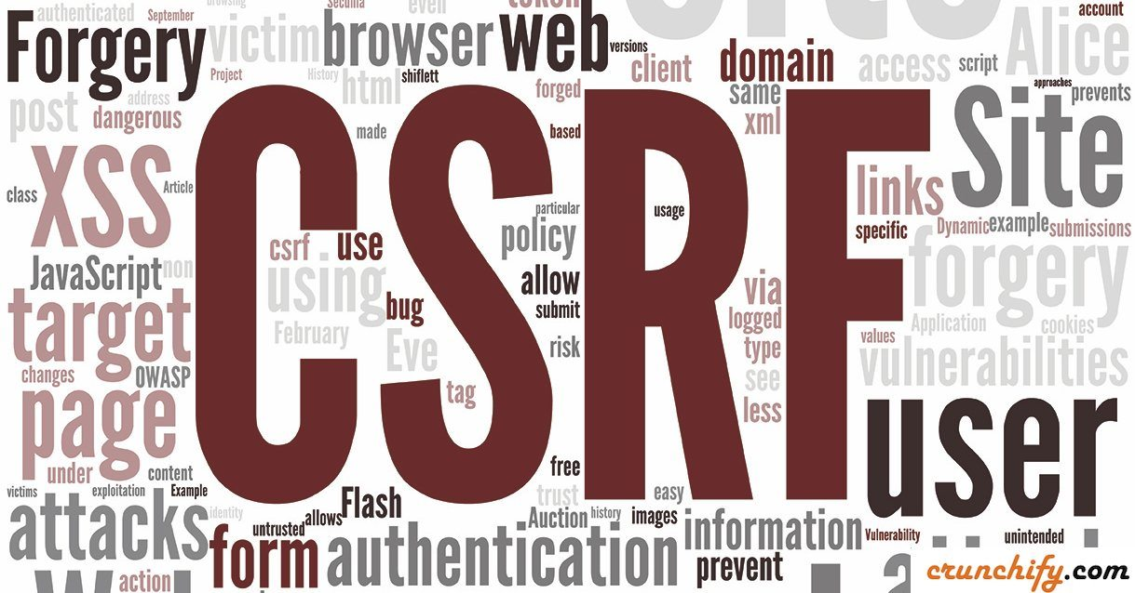
CSRF
Cross-Site Request Forgery

Slide 28
Spring CSFR Protection
AccessController.java
.csrf()
.csrfTokenRepository(csrfTokenRepository())
private CsrfTokenRepository csrfTokenRepository() {
HttpSessionCsrfTokenRepository repository =
new HttpSessionCsrfTokenRepository();
repository.setSessionAttributeName("_csrf");
return repository;
}
form.html
<input type="hidden" th:name="${_csrf.parameterName}" th:value="${_csrf.token}" />
<number>

Slide 29


Summary
Spring Security – framework that focuses on providing both authentication and authorization
Filters & Interceptors
Intercepting Requests
Modifying Request Chain Behaviour
<number>

Slide 30
https://softuni.bg/trainings/courses
Notes:
© Software University Foundation – http://softuni.org
This work is licensed under the Creative Commons Attribution-NonCommercial-ShareAlike license.
<number>

Slide 31













SoftUni Diamond Partners

Slide 32





SoftUni Organizational Partners

Slide 33




Trainings @ Software University (SoftUni)
Software University – High-Quality Education and Employment Opportunities
softuni.bg
Software University Foundation
http://softuni.foundation/
Software University @ Facebook
facebook.com/SoftwareUniversity
Software University Forums
forum.softuni.bg
Notes:
© Software University Foundation – http://softuni.org
This work is licensed under the Creative Commons Attribution-NonCommercial-ShareAlike license.
<number>

Slide 34

License
This course (slides, examples, demos, videos, homework, etc.) is licensed under the "Creative Commons Attribution-NonCommercial-ShareAlike 4.0 International" license
<number>
Notes:
© Software University Foundation – http://softuni.org
This work is licensed under the Creative Commons Attribution-NonCommercial-ShareAlike license.
<number>

